Slide 1

The Portal is dead, long live the portal
June 8, 2011,
David Wolowicz

Slide 2
Presentation Purpose
Provide a high level overview of UVic’s online evolution from a disparate set of web applications, to a central web portal, to an integrated user experience

Slide 3
Agenda
History
Challenges
The big questions
The solution

Slide 4
History
Implemented first central Portal in 2006, at the beginning of our ERP renewal project
The Portal was branded “uSource”
uSource had minimal ERP integration because ERP components not yet live
Content was mainly News, and static

Slide 5
History
As ERP (Banner) project progressed we:
Updated uSource to include ERP functionality e.g. Online pay stubs, student registration
Forced users to access other resources through the Portal e.g. Learning systems

Slide 6
Challenges
uSource did not look like UVic.ca
Too much static or irrelevant content
User’s frustrations with the new ERP system were focused on uSource
Aging technology stack
Notes:
Java 1.3, crashes at peak times,

Slide 7
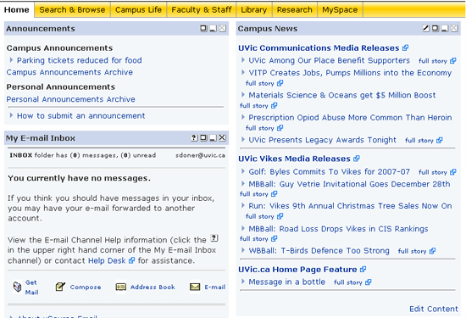
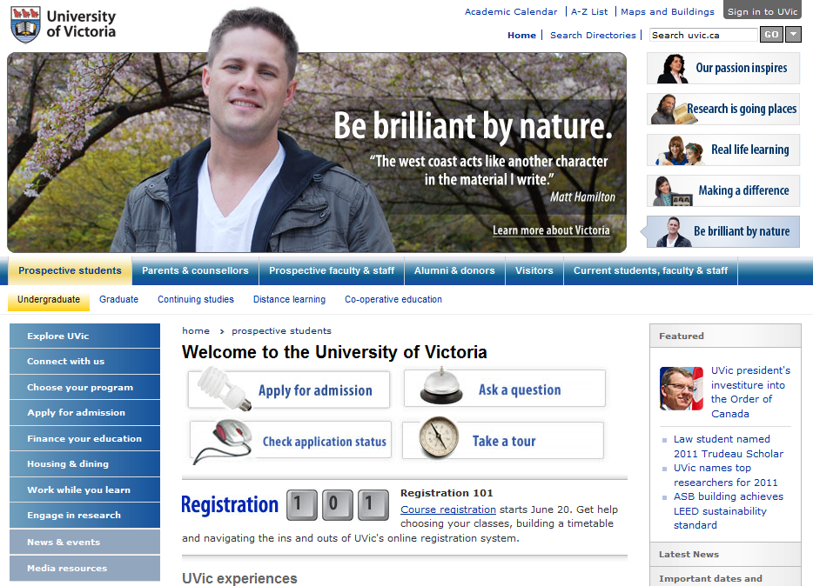
Challenges

Slide 8
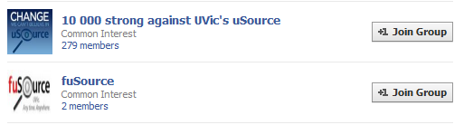
Challenges

Slide 9
Successes
Portal knowledge
Single Sign-On (SSO)
High usage...but because we forced them
Notes:
There were some successes too.
Things like our Portal knowledge, our base implementation of SSO

Slide 10
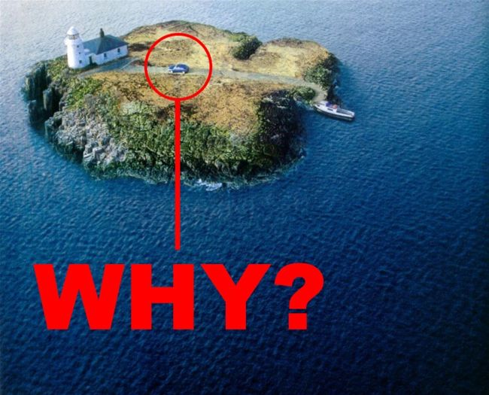
The big questions
1. Why have a portal?

Slide 11
The big questions
Why have a portal?
  Personal, customizable space
  Role based content
  Personal dashboards
  Single Sign-On (SSO)
Notes:
People were always want the website to just tell them what they need to know.

Slide 12
The big questions
Personal
Portal
E-Portfolio
Private
Public
Collaboration
Website
Group
Notes:
People were always want the website to just tell them what they need to know.

Slide 13
The big questions
2. Why have a separate portal site/brand?
  Easy to talk about?
  …?

Slide 14
The big questions
Reasons to integrate:
Lose the stigma associated with the brand
Consistency with other organizations
Users don’t care about the technology
User interface integration
Various technical efficiencies
Notes:
Technical: stats, SSO, Ajax, certs,…
Other organizations like Air Canada etc.

Slide 15
Solution Overview
Integrate portal functionality into UVic.ca
“Sign in to UVic”
Focus on the strengths of the portal within a broader user experience
Action based linking

Slide 16
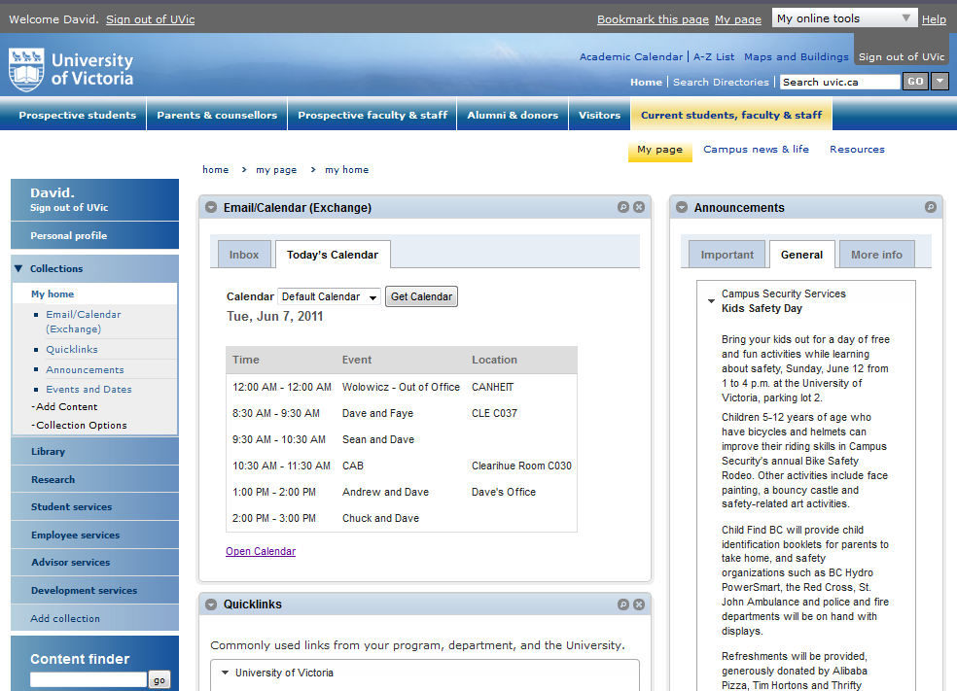
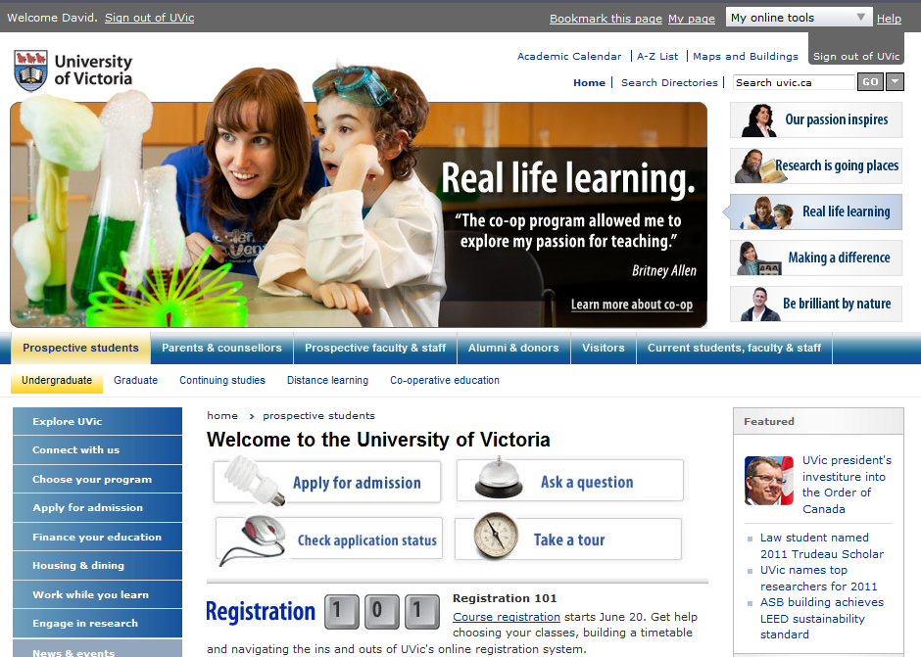
The Solution
Integrate portal functionality into UVic.ca

Slide 17
The Solution
Focus on the strengths of the portal within a broader user experience
Role based content
Easy customization
Application summaries
ERP integration
Mobile application

Slide 18

The Solution
“Sign in to UVic”
Central authentication
Signing into UVic signs you into everything
Integration points across “all” web sites

Slide 19
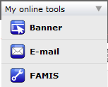
The Solution
“Sign in to UVic”

Slide 20
The Solution
Action based linking:
Go to uSource,
Sign in,
Go to Student,
Student Services,
Registration,
Add/Drop classes
“Register for classes”

Slide 21
Successes
Users like the new interface
Mobile version of “My page”
Technically stable
Easy to customize
The project
Notes:
Leadership
Making the Decisions
launching.

Slide 22
Challenges
The name, or lack there of
Educating web contributors
Getting more, up-to-date content

Slide 23
Questions?
David Wolowicz
Manager of Web Services
wolowicz@uvic.ca
250.721.6117

